Slide 1
Financial Environment
Overview of Financial Environment
Financial Instruments
Financial Markets
Functions
Types
Financial Institutions
Depository and non depository financial institutions

Slide 2
Financial Environment
Components:
Financial Market
Saving Surplus Units
Financial Market
Financial Market
Financial Intermediaries
Saving Deficit Units
Financial Market

Slide 3
Capital Allocation Process
On one hand:
Individual (5m needed have only 3m on hand)
Banks and financial institutions (increase paid of capital apart from retained earning)
Government (need funds to finance general and development activities)
Individuals, Business organization as well as government must rely on financial markets to raise required funds
On other hand:
Individual (income greater than saving)
Business organization(have surplus cash)
Government
Individuals, Business organization and Government with surplus cash also requires financial market
In well functioning financing system, saving generated by surplus unit are transferred to deficits unit for investment

Slide 4
Capital Allocation Process
Direct Transfers
securities (stock or bonds)
Funds
b. Indirect transfers through Investment Bankers
Securities Securities
Funds Funds
c. Indirect transfers through Financial Intermediary
Securities Securities
Funds Funds
Business
Savers
Business
Investment Bankers
Savers
Business
Financial Intermediary
Savers

Slide 5
Financial Instruments
Refers to a legal representation of the right to receive prospective future benefits under stated condition.
Financial instruments are also vehicles of financial market.
Two characteristics of FI from investors perspective (i) return it promises and (ii) risk inherent in the return
Characteristics of Financial Instruments are:
Return
Risk
Liquidity
Functions
Means of Payment
Means of raising funds
Store of value
Means of transferring risk
Means of speculation

Slide 6
Types of Financial Instruments
Non Marketable
Saving Account
Non negotiable CDs
Marketable
Money Market Securities
Indirect Investment
Government Saving Bond
Capital Market Securities
Derivative Securities
Money Market Deposit Accounts

Slide 7
Types of Marketable Securities
Money Market Securities
Treasury Bills
Re-purchase Agreement
Capital Market Securities
Corporate Bonds
Treasury Notes and Bonds
Derivatives
Options
Futures
Indirect Investment
Euro Dollars
Commercial Papers
Negotiable CDs
Bankers Acceptance
Municipal Bonds
Common Stock
Preferred Stock
Rights and Warrants
Unit Trust
Investment Trust
Hedge Funds

Slide 8
Financial Market
The market which deals with transactions of financial instruments and services.
Bring buyer and seller of financial assets and services together
Brings lender and borrower of funds together with the help of financial intermediaries directly or indirectly.
“The financial markets channel saving which come mainly from households to those individuals and institutions who need funds for spending then are provided by current income” (Peter S. Rose)
Importance (Functions) of Financial Markets:
Facilitate the trading of financial assets
Improve liquidity and help in price discovery of securities
Facilitate transformation of saving into investment
Satisfy financing need of Businesses and Households

Slide 9
Types of Financial Markets
Primary Market and Secondary Markets
Primary (Seasoned and unseasoned)
Secondary (Organized Exchange and Over the Counter )
2. Money Market and Capital Market
Spot Market and Future Market
Physical Assets Market and Financial Assets Market
National and International Market

Slide 10
Financial Institutions/ Intermediaries
Specialized firms dealing with financial services and facilitating transfer of funds from savers to users.
Acts as intermediaries between issuer of securities and investing people
Concern on structure and items of financial statements
Types of Financial Institutions / Intermediaries
Financial Institutions
Depository Institution
Non Depository Institution
Banks
Insurance Companies
Credit Unions
Pension Funds
Savings and Credit Associations
Brokerage Firms
Mutual Funds Companies

Slide 11
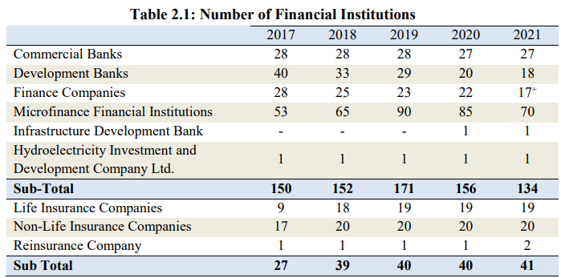
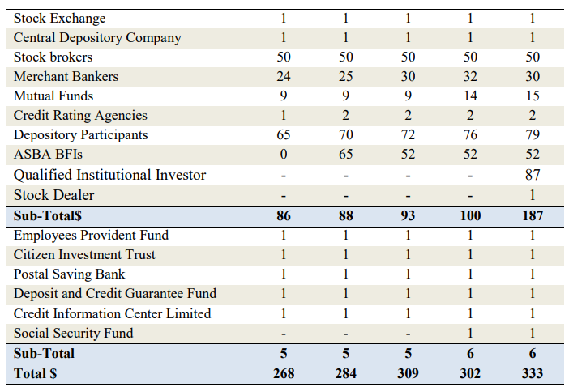
Growth of Financial Institutions in Nepal
As of mid July 2021

Slide 12
Role of Financial Institutions/ Intermediaries
Allocate Saving into Investment (Direct and Indirect)
Provide Financial Services
Provide Satisfactory Returns and Minimize Risk of loss
Help Business in Raising Funds
Risk Diversification
Cost Reduction
Payment Mechanism
Transformation of Financial Assets

